Slide 1
Enlarging objects
Transformations

Slide 2
how to use Oak lessons

Slide 3
I can enlarge objects using information about the centre of enlargement and scale factor.

Slide 4
The centre of enlargement is the point from which a shape is enlarged.
Scale factor is the multiplier between similar shapes that describes how large one shape is compared to the other.

Slide 5

Enlarging objects
Enlarging using an integer scale factor
Enlarging using a non-integer scale factor

Slide 6
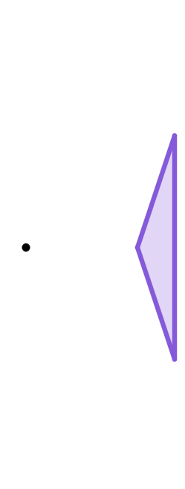
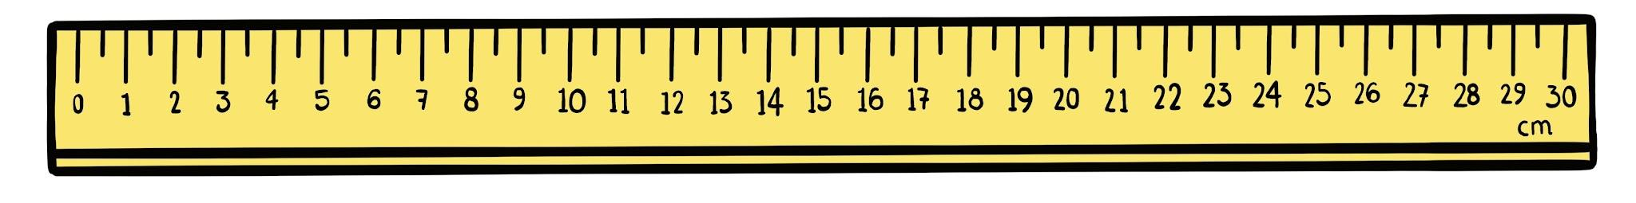
Enlarging using an integer scale factor
Enlarge the triangle by a scale factor of 2 from the centre of enlargement.
Method 1: measuring with a ruler
Draw a line through a vertex from the centre of enlargement.
Measure the distance.
Multiply the distance by the scale factor and mark the corresponding vertex in the image.
Join up the new vertices.

Slide 7
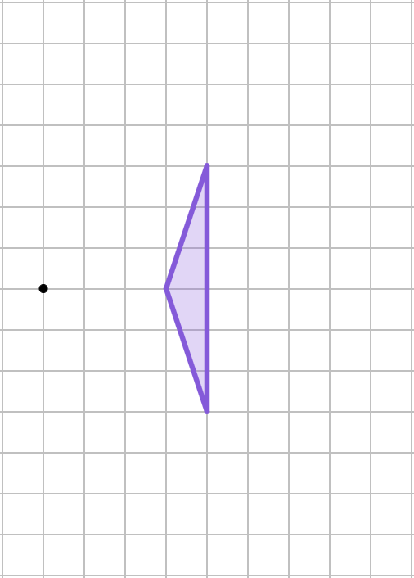
Enlarging using an integer scale factor
Enlarge the triangle by a scale factor of 2 from the centre of enlargement.
8
Method 2: count squares
Choose a vertex on the object.
4
6
× 2
Starting at the centre of enlargement, travel along the grid to the vertex.
3
× 2
Count the number of squares you travel in each direction.
3
6
3
6
× 2
Multiply by the scale factor.
4
Mark the corresponding vertex.
8
Join up the new vertices.

Slide 8
Enlarging using an integer scale factor
Enlarge the triangle by a scale factor of 2 from the centre of enlargement.
Method 3: mark just one point
Use any method to find the position of the first vertex on the image.
Measure the distance between two vertices on the object.
6
× 2
12
3
Multiply by the scale factor.
6
Use your answer to find a new vertex on the image.
1
× 2
Join up the new vertices.
2

Slide 9
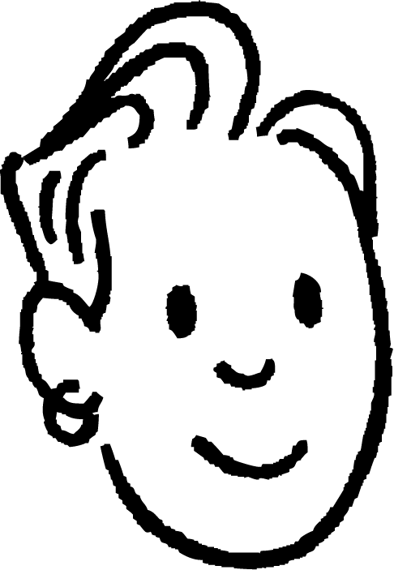
Enlarging using an integer scale factor
Sam is enlarging the object below by a scale factor of 3.
They measure distance from the centre of enlargement to the first vertex.
How far will its corresponding vertex be from the centre of enlargement?
object
4 cm
4 × 3 = 12 cm

Slide 10
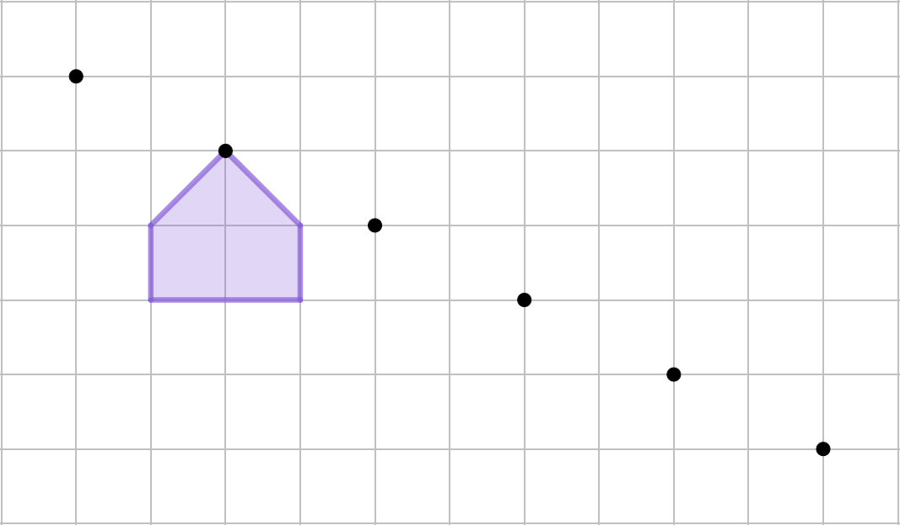

Enlarging using an integer scale factor
The shape is being enlarged by a scale factor of 4. Which is the correct position for the corresponding vertex?
A
centre of enlargement
B
A
C
B
C
D
D

Slide 11
Enlarging using an integer scale factor
When the centre of enlargement is at one of the object’s vertices, the distance between that and its corresponding vertex on the image will be 0.
That point will be invariant.
The shapes will overlap.

Slide 12
Enlarging using an integer scale factor
Lines can also be used to check that the image is in the correct position.
All the vertices of the image should be on a line.
correct position
image too low
one vertex wrong

Slide 13
Enlarging using an integer scale factor
The enlargement has been drawn correctly.
Some of the vertices in the image are not on a line.
The image is an enlarged version of the object.

Slide 14
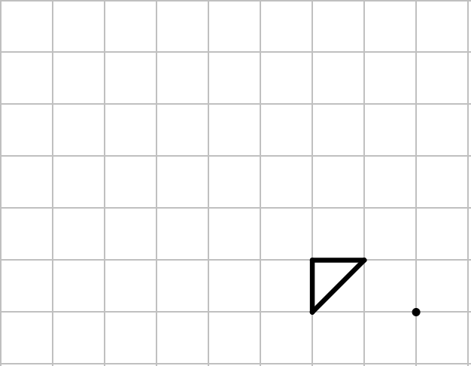
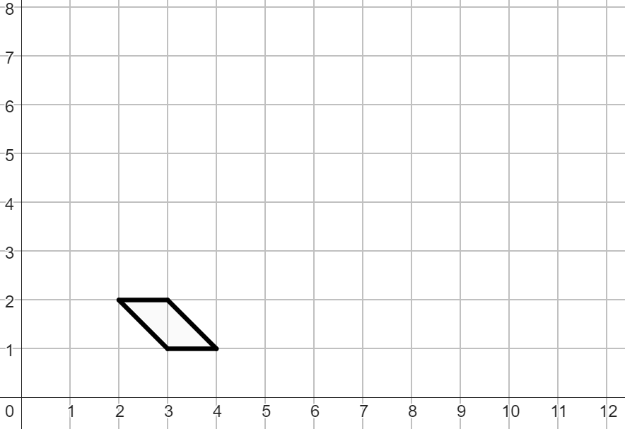
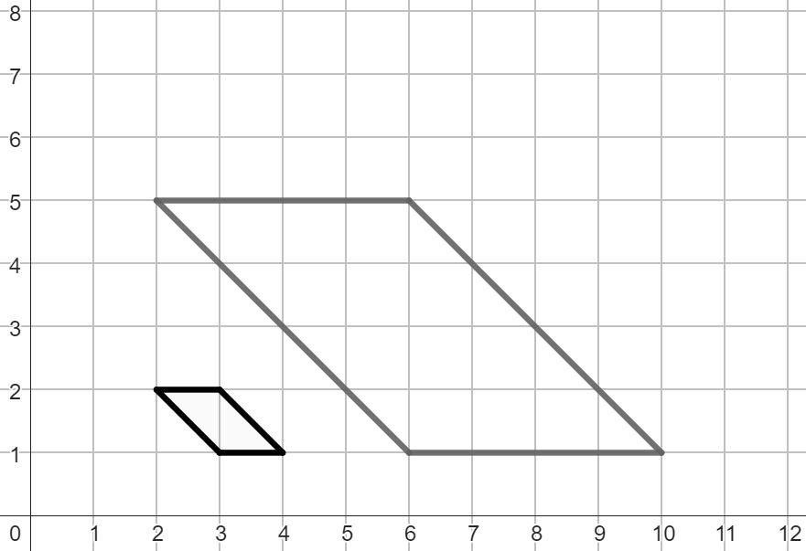
Enlarging using an integer scale factor
1) Enlarge the object by a scale factor of 3 from the point marked.
2) Enlarge the object by a scale factor of 4 from the point (2, 1).

Slide 15
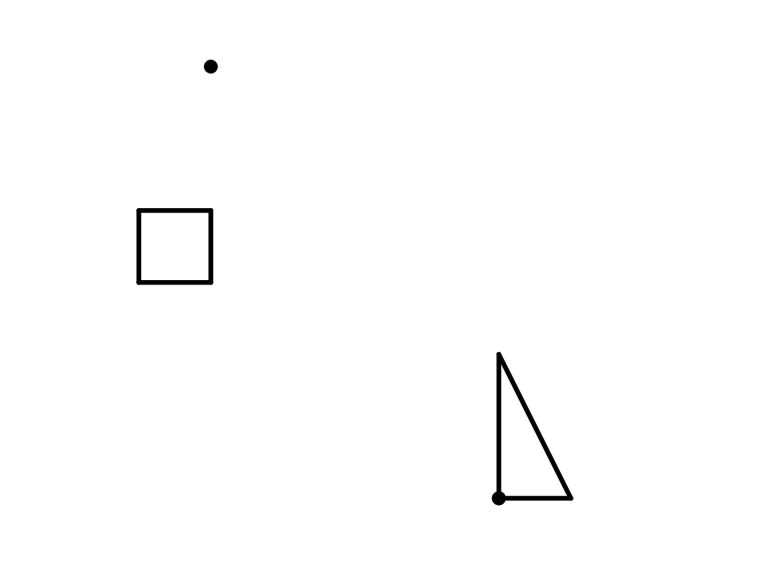
Enlarging using an integer scale factor
3) Enlarge the object by a scale factor of 2 from the point marked.
4) Enlarge the object by a scale factor of 3 from the marked vertex.

Slide 16
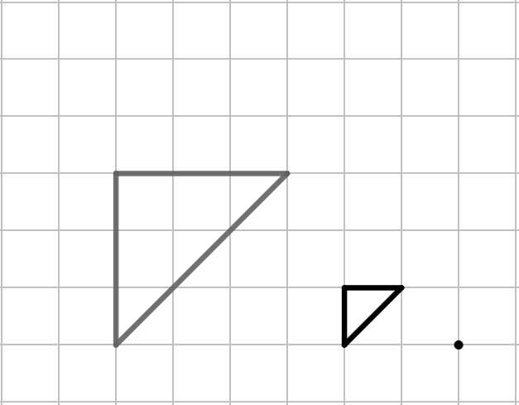
Enlarging using an integer scale factor
1) Enlarge the object by a scale factor of 3 from the point marked.
2) Enlarge the object by a scale factor of 4 from the point (2, 1).

Slide 17
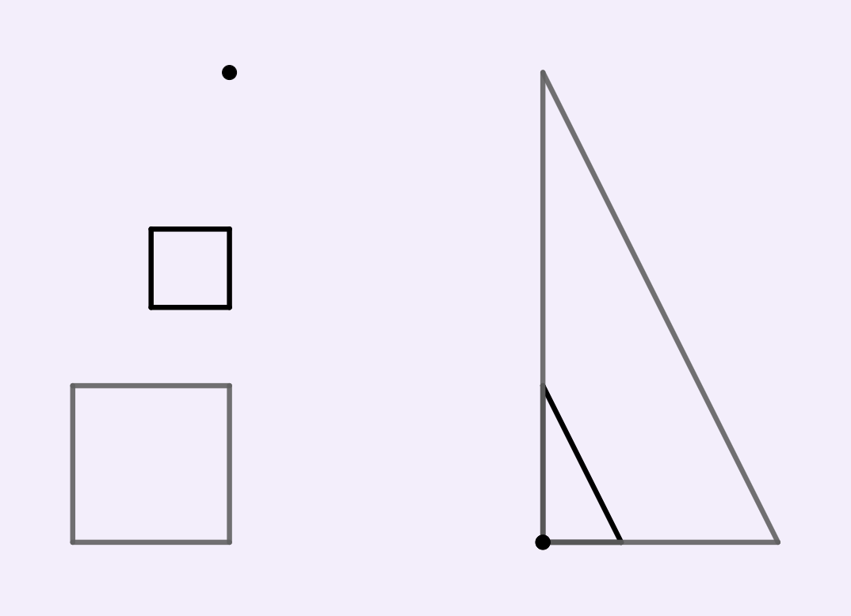
Enlarging using an integer scale factor
3) Enlarge the object by a scale factor of 2 from the point marked.
4) Enlarge the object by a scale factor of 3 from the marked vertex.
Measure and check f = 2e
a
Measure and check a = b
f
b
Measure and check h = 2g
Measure and check c = d
c
e
d
g
h

Slide 18
Enlarging objects
Enlarging using an integer scale factor
Enlarging using a non-integer scale factor

Slide 19

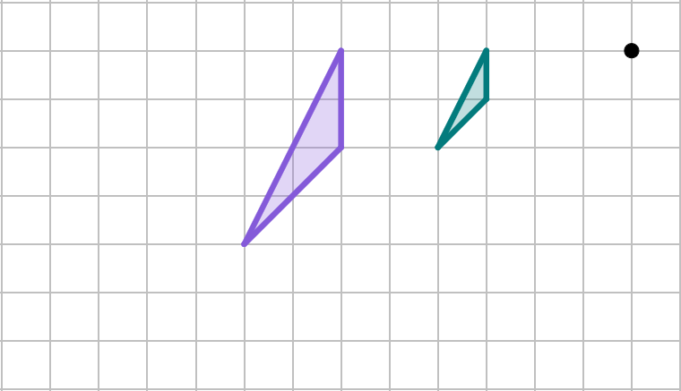
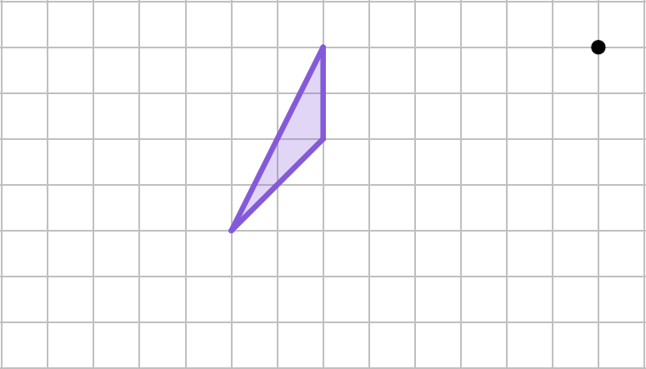

Enlarging using a non-integer scale factor
Enlarge the triangle by a scale factor of from the centre of enlargement.
6
3
1
3
2
6
4
4
8

Slide 20

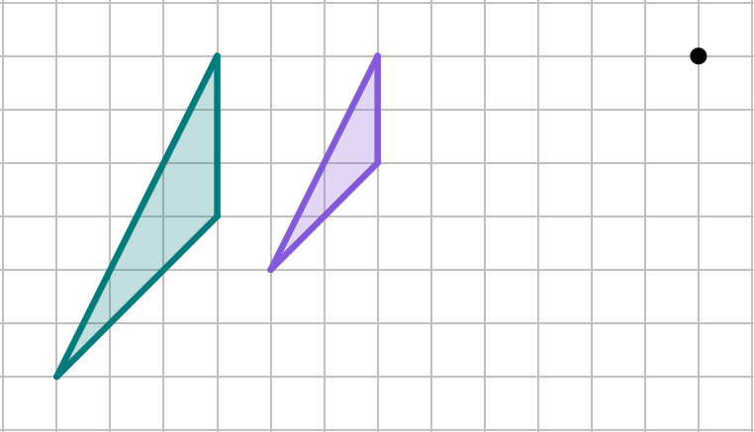
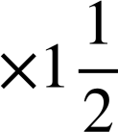
Enlarging using a non-integer scale factor
Enlarge the triangle by a scale factor of from the centre of enlargement.
9
6
2
6
3
4
9
6
8
12

Slide 21

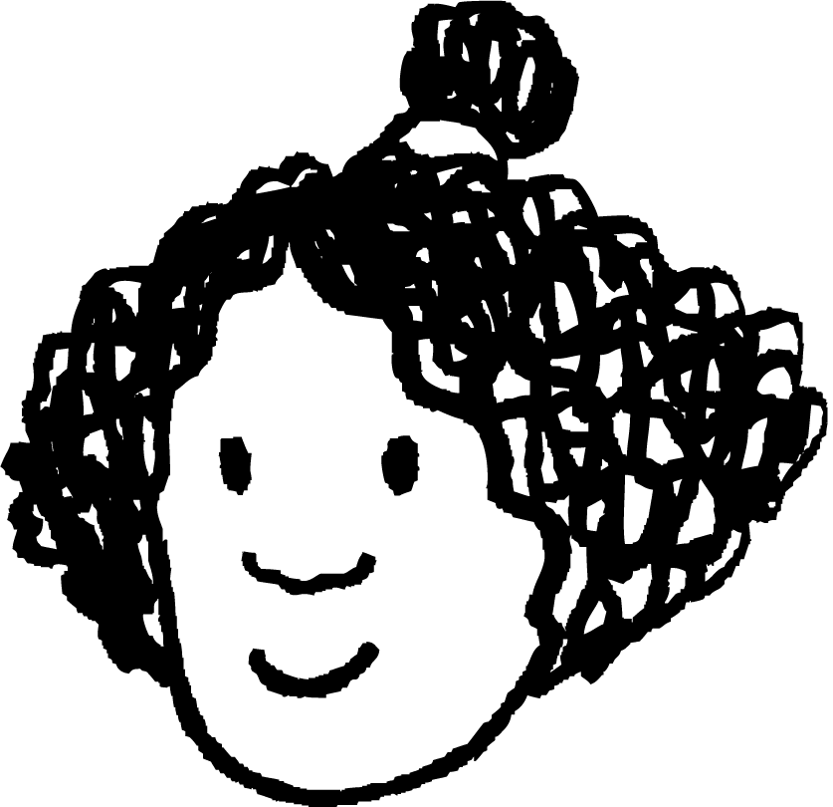
Enlarging using a non-integer scale factor
Izzy is about to enlarge the object below by a scale factor of . What will the height of the image be?
4 × 2 = 8
4 × = 2
4 cm
4 × = 10 cm

Slide 22

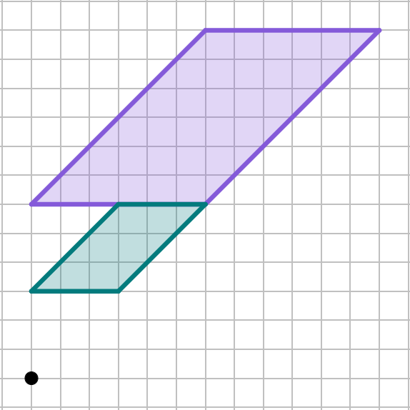
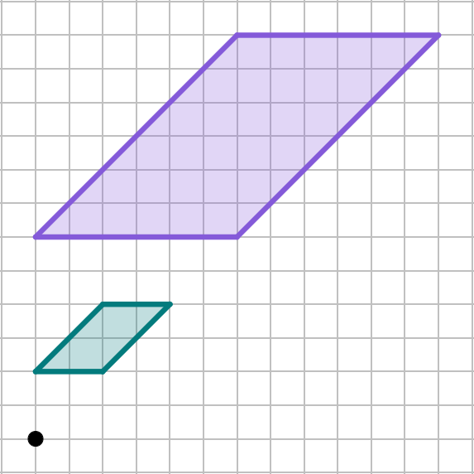
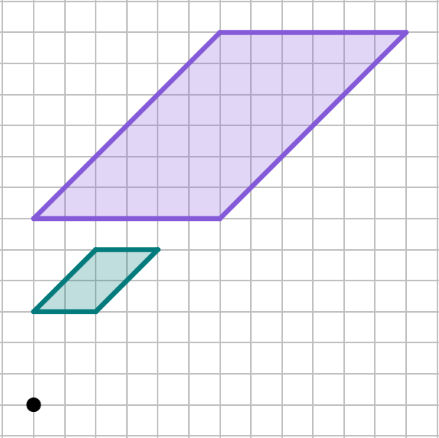
Enlarging using a non-integer scale factor
Which diagram has correctly enlarged the object by a factor of ?
object
object
object
image
image
image

Slide 23
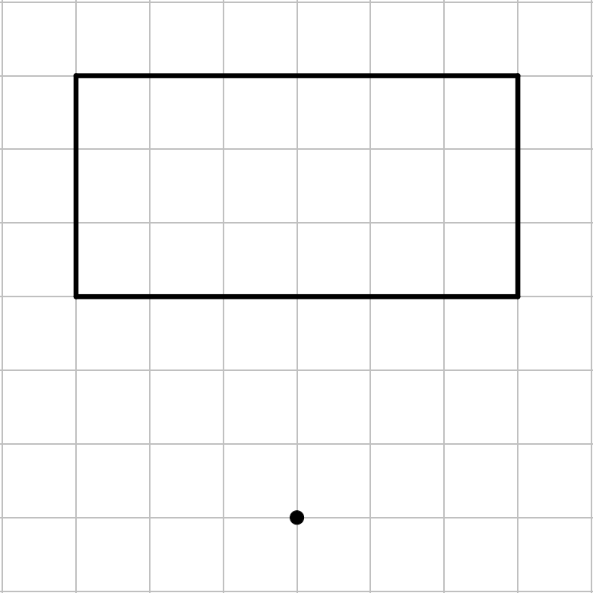
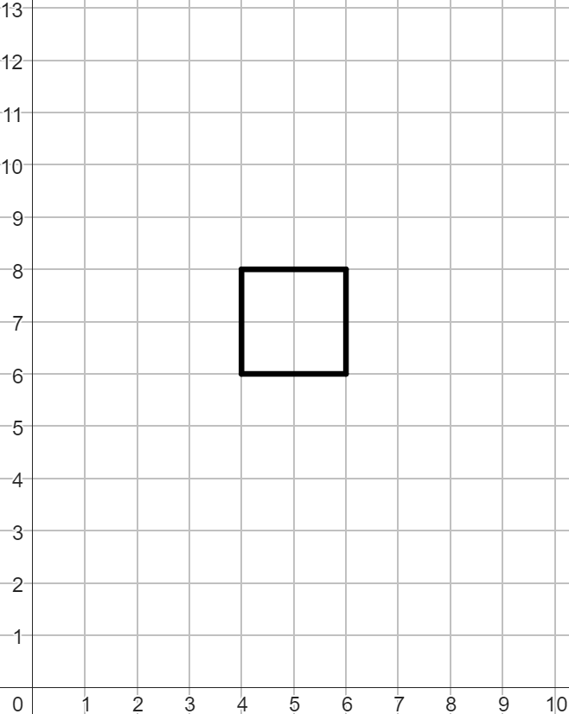
Enlarging using a non-integer scale factor
1)
a) Enlarge the object by a scale
factor of from the point marked.
b) Enlarge the object by a scale
factor of from the point (4, 0).

Slide 24
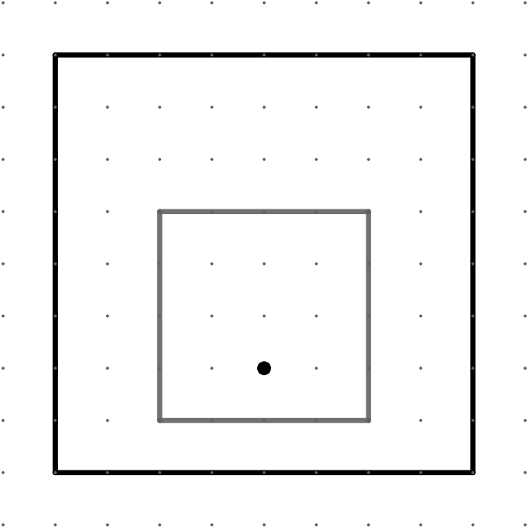
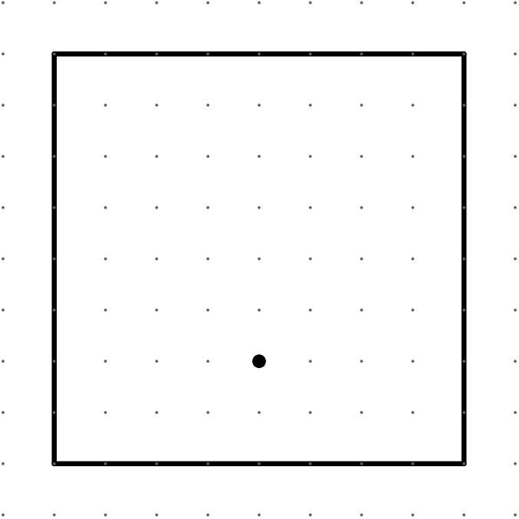

Enlarging using a non-integer scale factor
2)
a) Enlarge the object by a scale
factor of from the point marked.
b) Enlarge the object by a scale factor of from the point marked.

Slide 25
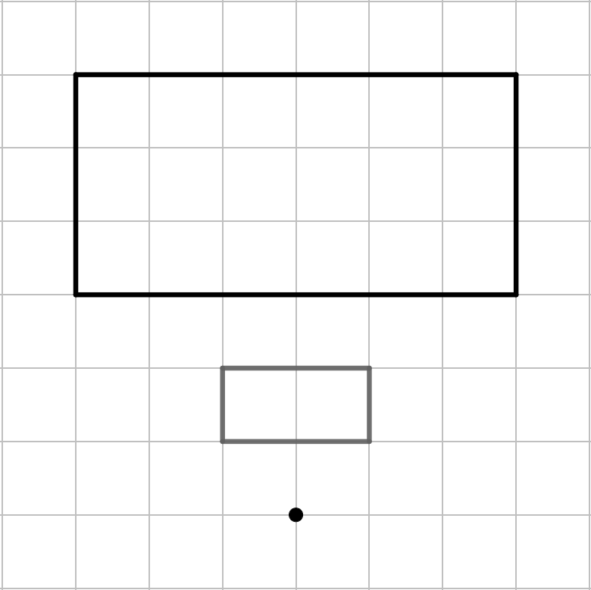
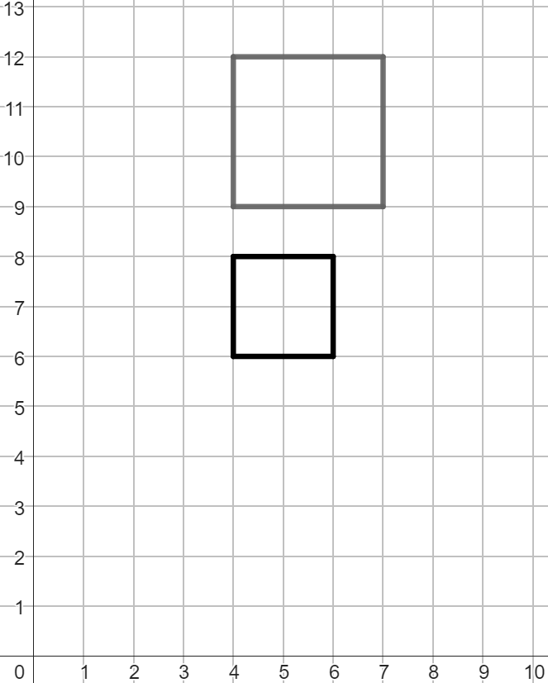
Enlarging using a non-integer scale factor
1)
a) Enlarge the object by a scale
factor of from the point marked.
b) Enlarge the object by a scale
factor of from the point (4, 0).

Slide 26
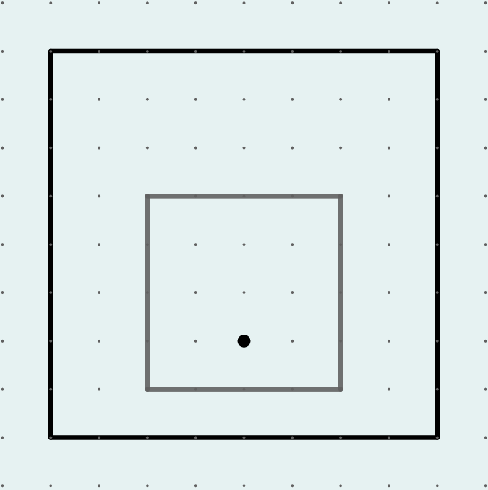
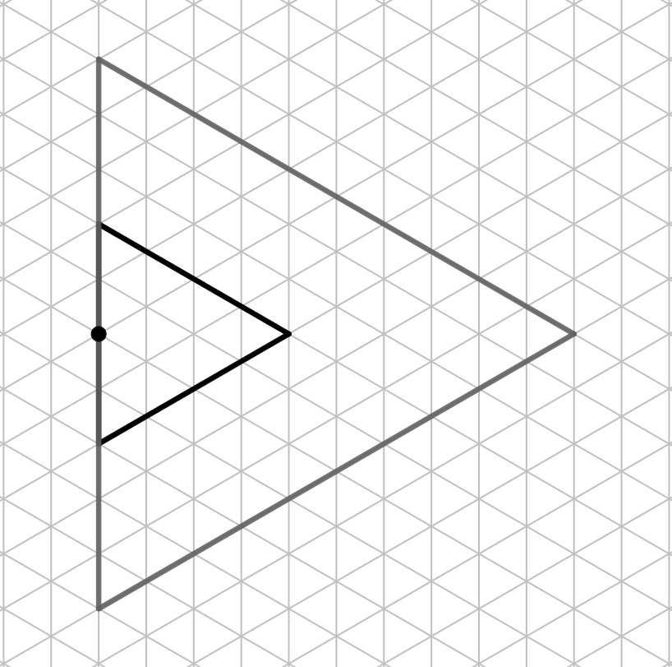
Enlarging using a non-integer scale factor
2)
a) Enlarge the object by a scale
factor of from the point marked.
b) Enlarge the object by a scale factor of from the point marked.

Slide 27
Enlarging objects
Different methods can be used to enlarge objects.
Lines from the centre of enlargement passing through the object’s vertices can be drawn to check that an image is in the correct position.
When a line joins the centre of enlargement and a vertex of the object, it should also intersect the corresponding vertex of the image.

Slide 28

© Oak National Academy 2023.
Produced in partnership with Mathematics in Education and Industry.
Licensed on the Open Government Licence v3.0, except where otherwise stated. See Oak terms and conditions.

